Slide 1
Predictive Error-Driven Learning in the Brain
Randall C. O’Reilly
University of California Davis
eCortex, Inc

Slide 2
Major Points
Biological mechanism for predictive learning: statistical learning, etc
Dorsal pathway learns first, soaks up spatial errors, leaving object-based residuals
Same circuits used for attention

Slide 3
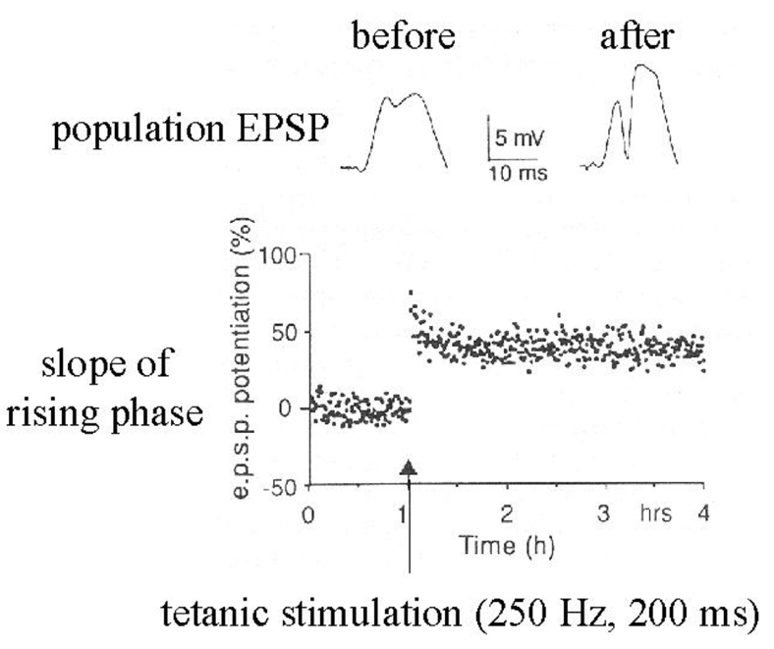
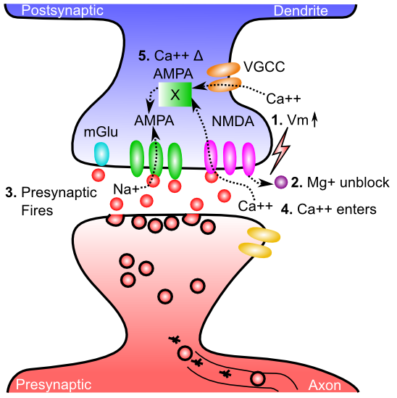
Neuroscience: Hebbian

Slide 4
Hebbian is too Dumb!
Babies exhibit some serious active, theory-like learning abilities!
Not just passive soaking up of statistics..

Slide 5
Key idea: We learn by constantly generating hypotheses or predictions about what will happen next!

Slide 6
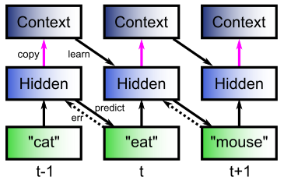
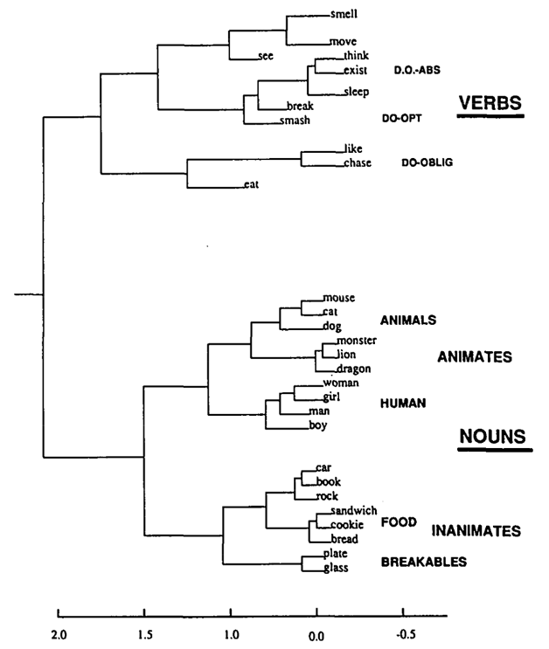
The Predictive Bootstrap (Elman 1990; Elman, Bates, et al. 1996)
Learning to predict words induces verb vs noun category representations in hidden layer of SRN
The future is free!
If you can predict it, you know it!

Slide 7
“Standard” approach (Friston et al)
Explicit error-coding neurons subtracting top-down vs. bottom up
But: no evidence of such cells!

Slide 8
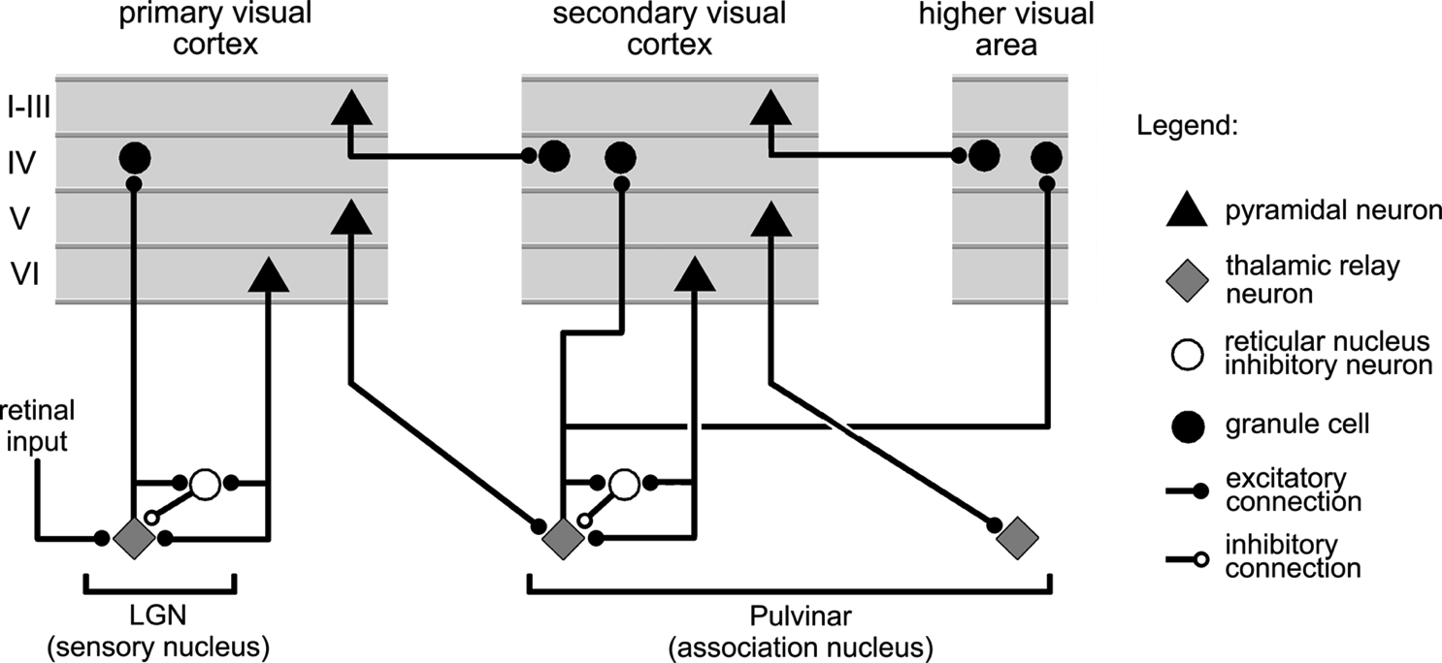
Thalamocortical Loop Biology (Sherman & Guillery, 2006)
5IB
FF
Driver
Weak
FB
“What happens”
Prediction

Slide 9
The Pulvinar = Projection Screen (c.f. Mumford, 1991 “blackboard”)
Pulvinar receives connections from all over visual cortex
and projects back out to these same areas
Two inputs:
1. Few strong feedforward:
“what happens”
2. Many weaker feedback:
prediction
Pulvinar!

Slide 10
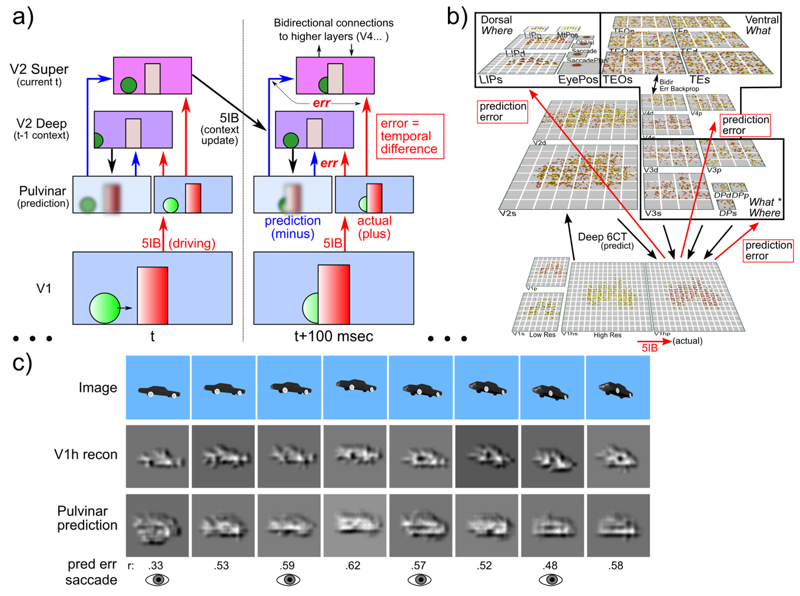
Deep Predictive Learning

Slide 11
Temporal Difference Error

Slide 12
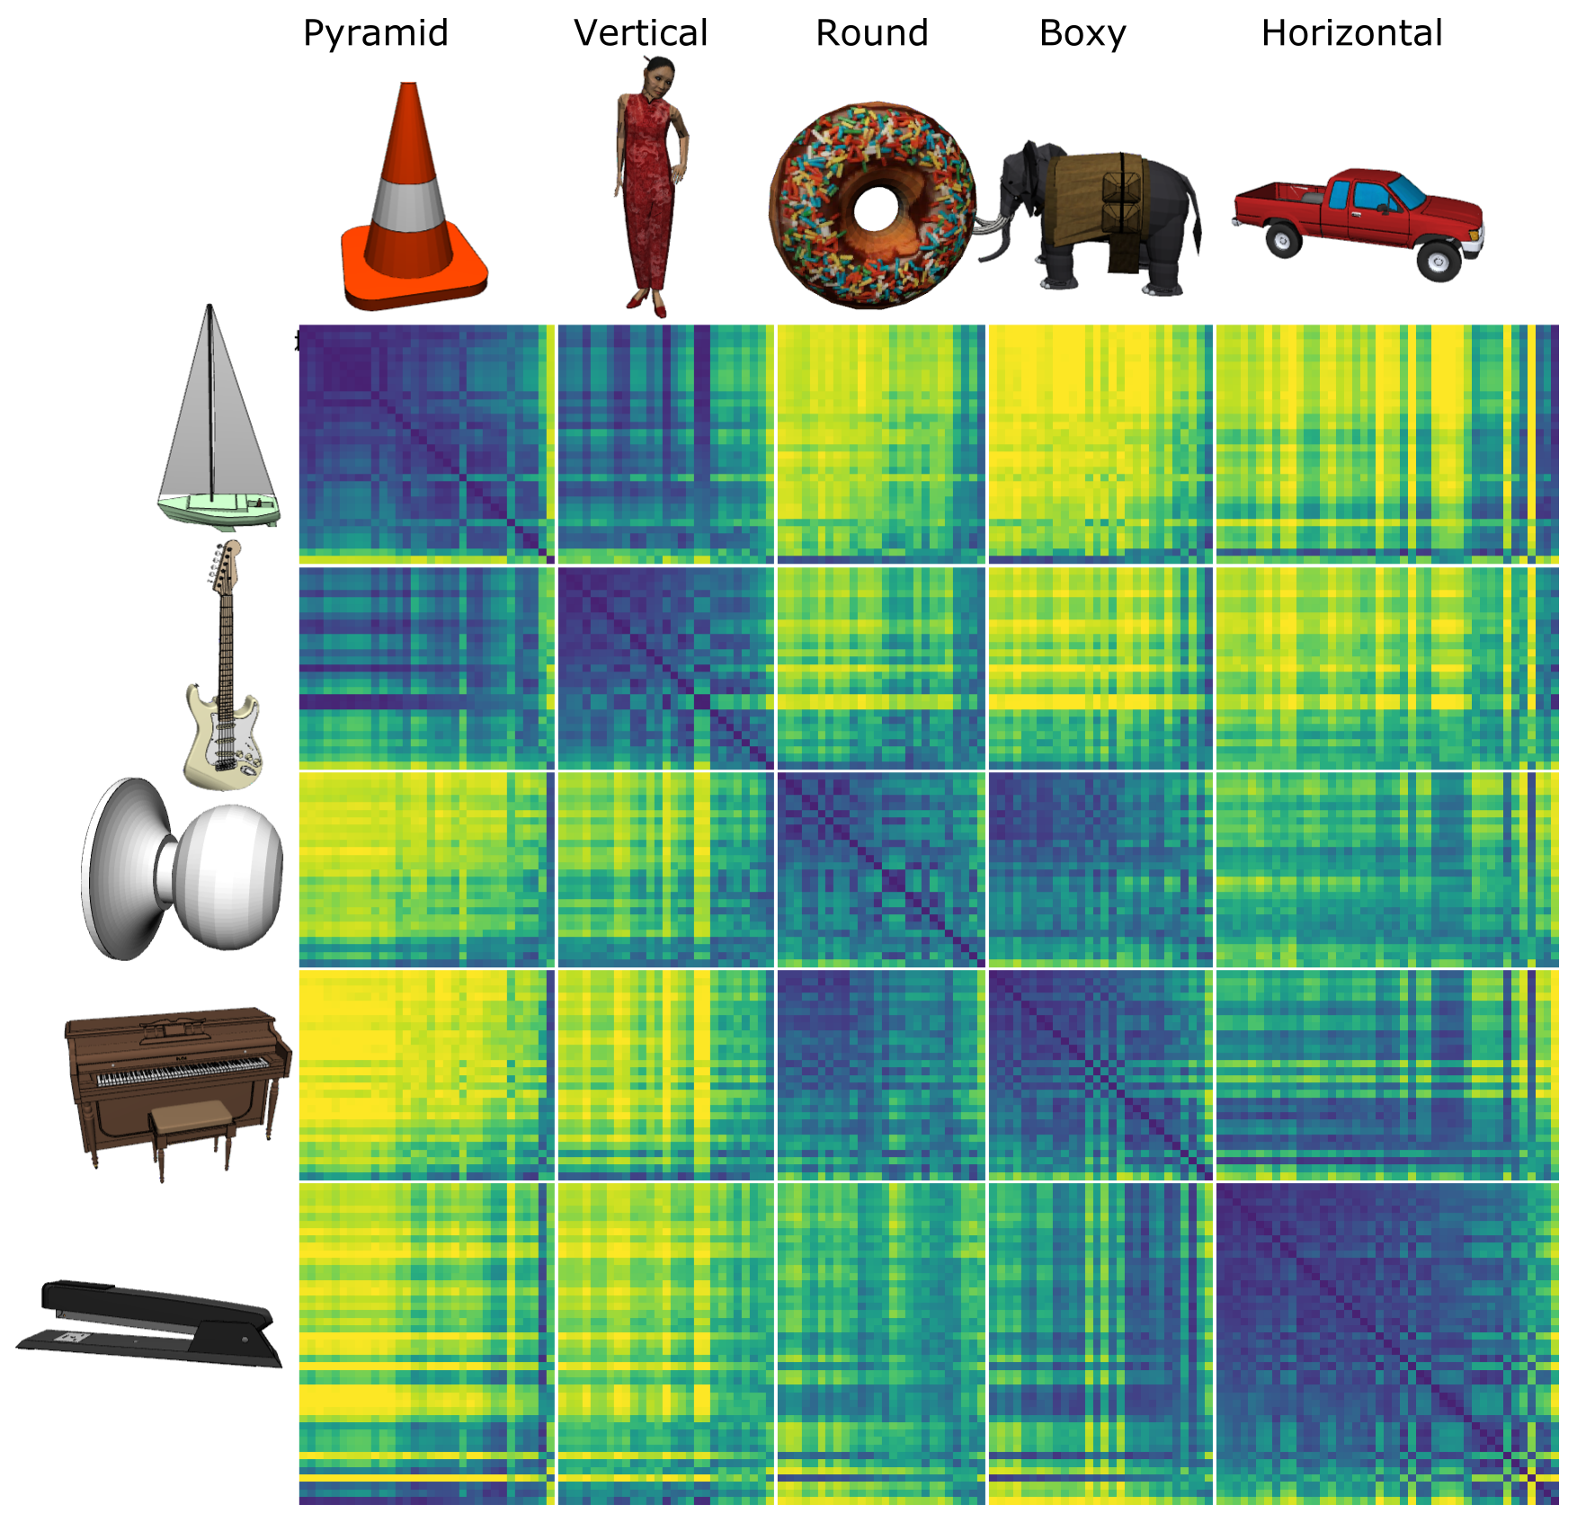
Model discovered
Shape categories!

Slide 13
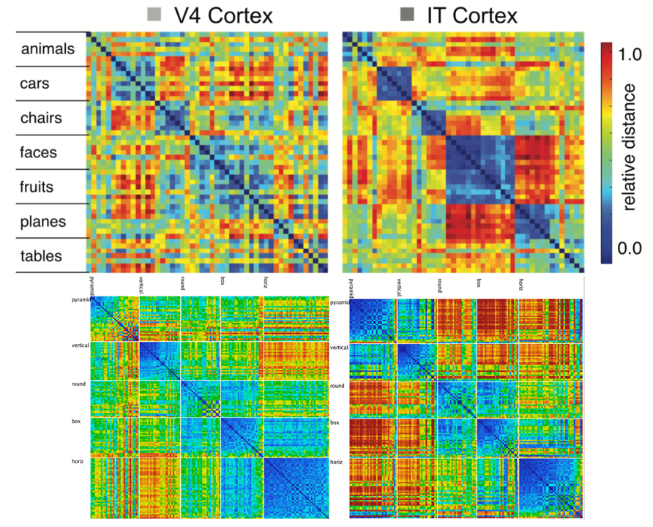
Model vs. Monkeys: Categories Emerge in Higher Layers

Slide 14
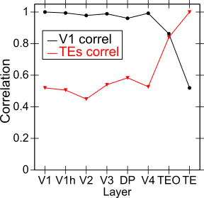
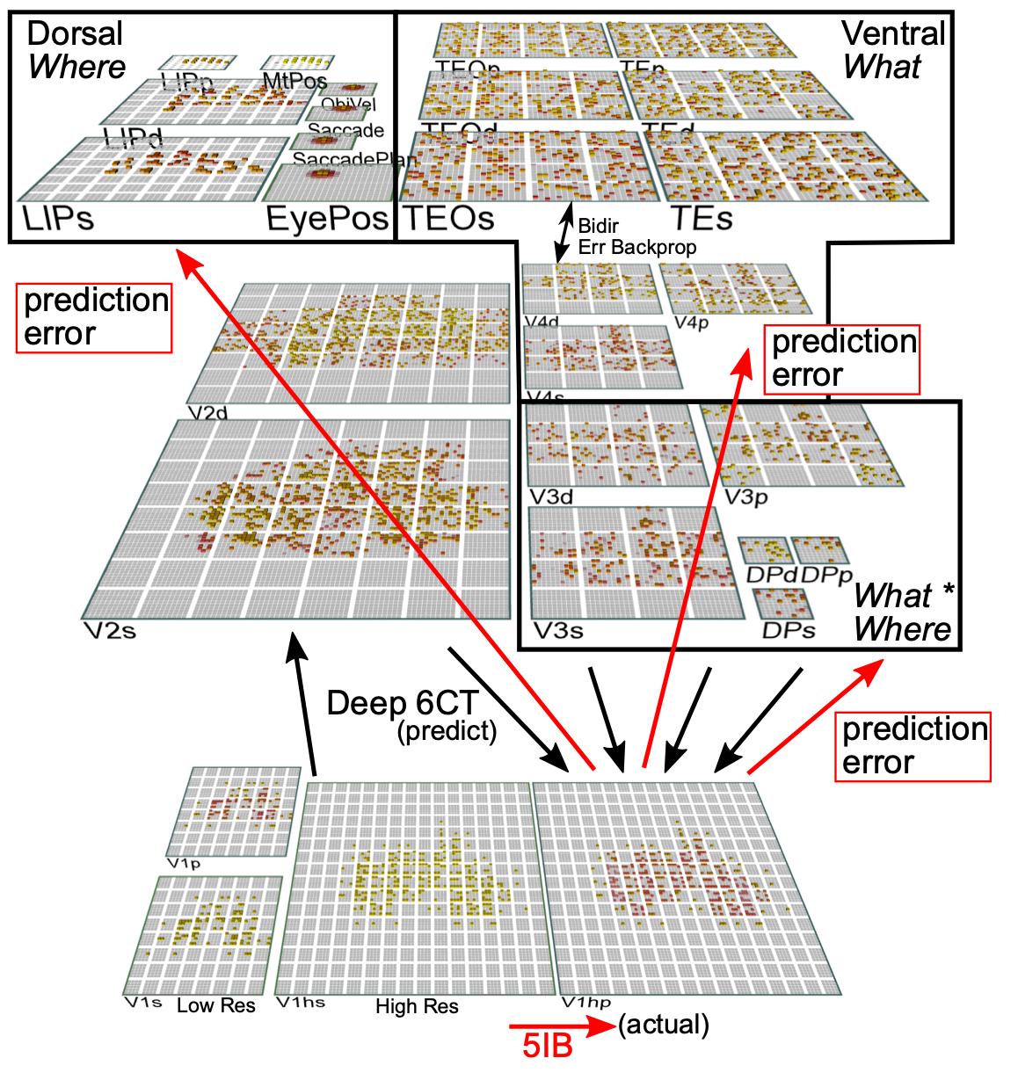
Categories not in V1; Emerge in IT Obj Rec Pathway

Slide 15
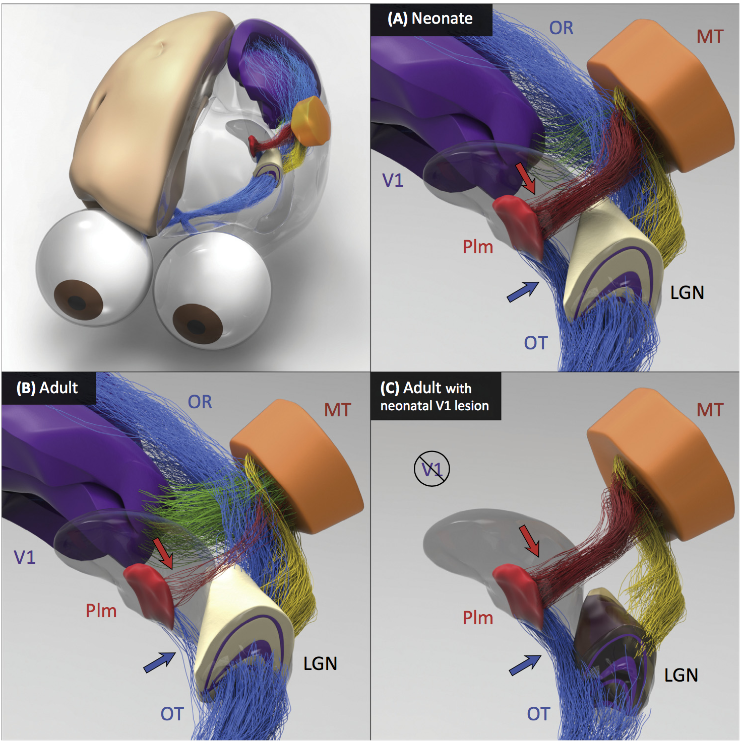
Neonate has direct shortcut connections from LGN to Pim = Pulvinar which then trains area MT as key input to the “where” visual pathway
Adult loses this retinal shortcut, has more cortical (V1, etc) drive.
This shortcut is essential for our model to learn high-level spatial representations first, to enable effective visual predictions.

Slide 16
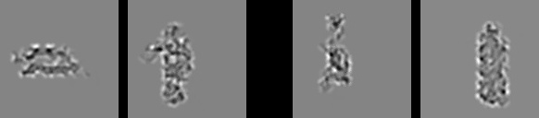
Model vs. Humans
Which pair is more similar in terms of overall shape?

Slide 17

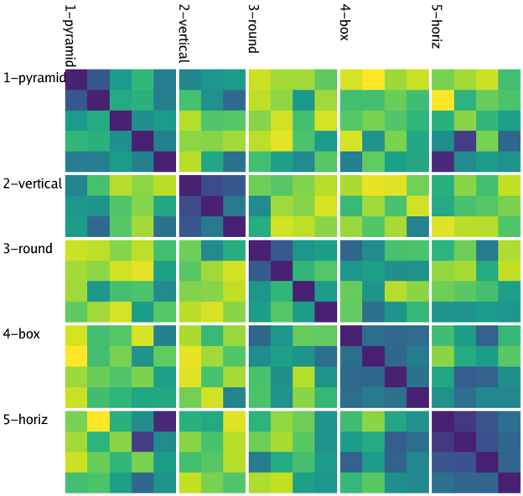
Model
People

Slide 18
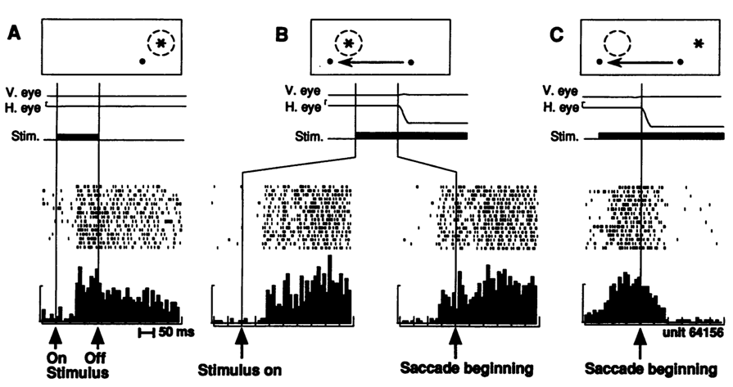
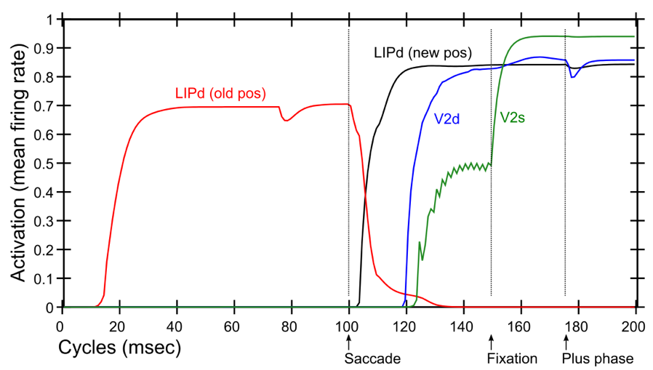
Predictive Remapping
Duhamel et al. (1992):
LIP neurons anticipate effect of saccade, start firing for new location before fixation lands (even before saccade)
Model:
LIPd remaps first at high, abstract level, drives top-down remapping in lower areas – consistent with Cavanagh et al. (2010)

Slide 19
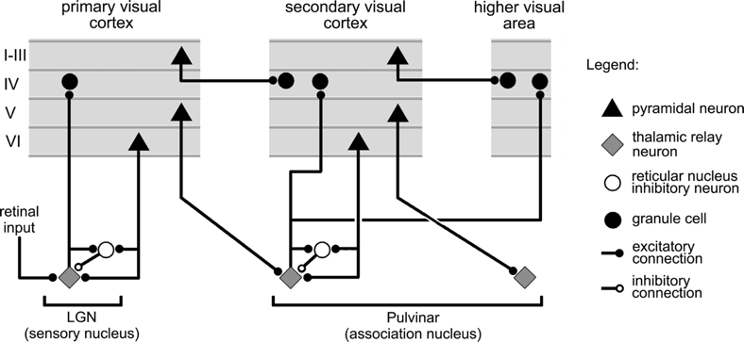
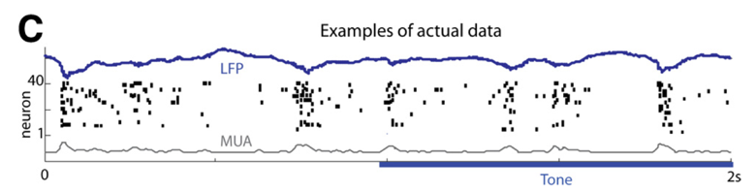
Key Biological Data
Strong, synchronized, low-frequency modulation of cortex (at the alpha frequency).
Specificity of alpha modulation to deep layers & thalamus, not superficial layers.
Nature of deep-layer connectivity to pulvinar: numerous, weaker, plastic pathway (for generating a prediction) and sparse, strong, fixed pathway (for ground truth target).
Synchronization of this strong pathway input with the alpha cycle.
Broad connectivity of pulvinar with different visual pathways (afferent and efferent).
Lack of direct bottom-up superficial projections into the deep layers (would short-circuit prediction), but presence of these projections top-down (beneficial).
Bidirectional (top-down and bottom-up) connectivity between superficial layers.
Early development of the Where (MT, LIP) pathway.
Organization into three separable (yet highly interconnected) visual pathways, particularly a third putative What*Where integration pathway.
(Buffalo et al., 2011; van Kerkoerle et al., 2014; Shipp, 2003; VanRullen & Koch, 2003; Luczak et al., 2013..)

Slide 20
Conclusions
Peculiar features of connectivity between cortex and thalamus support form of predictive learning (many diffs from Friston etc).
Computational model shows that predictive learning from raw visual “movies” self-organizes abstract categorical object representations (based on shape, not texture!)

Slide 21
Key Diffs From Friston / Bayes
Friston et al: errors go up, predictions come down
Us: full activation goes up & down, predictions go to pulvinar, errors are temporal differences.
Both models account for increased activity for unexpected outcomes.

Slide 22
Thanks To
CCN Lab
Will Chapman
Tom Hazy
Seth Herd
Kai Krueger
Jessica Mollick
Ananta Nair
John Rohrlich
Jake Russin
Dean Wyatte
Maryam Zolfaghar
Collaborators
Jonathan Cohen
Alex Petrov
Christian Lebiere
Tim Curran
David Sheinberg
Funding
ONR – Hawkins & McKenna

Slide 23
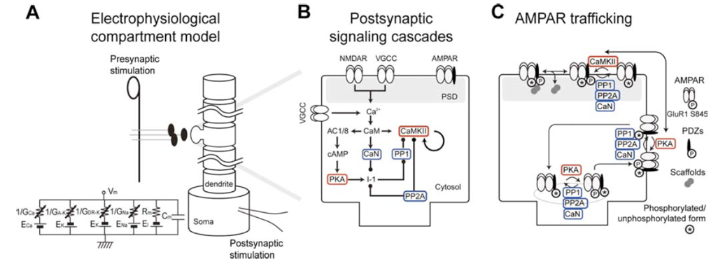
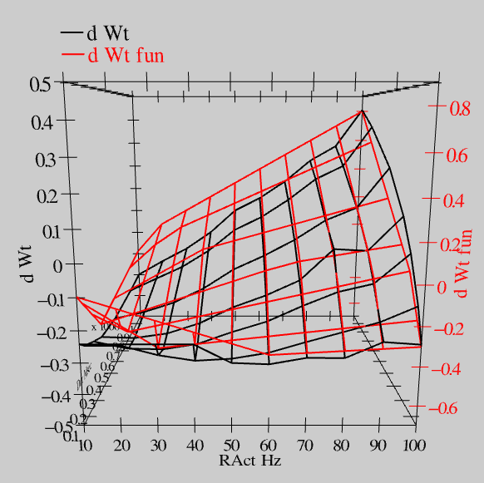
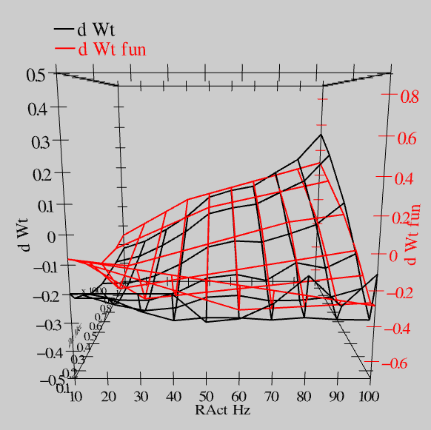
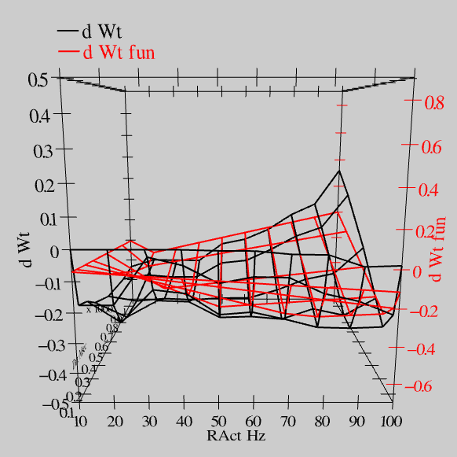
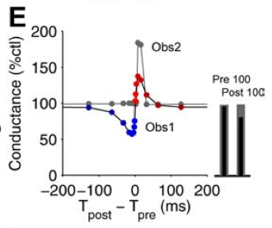
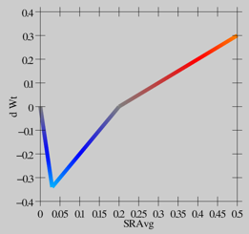
Synaptic Plasticity: XCAL Model (reduction of Urakubo et al, 2008 STDP model)
S = 100Hz
S = 50Hz
S = 20Hz
dW = f(send * recv) =
(spike rate * duration)
r=.894

Slide 24
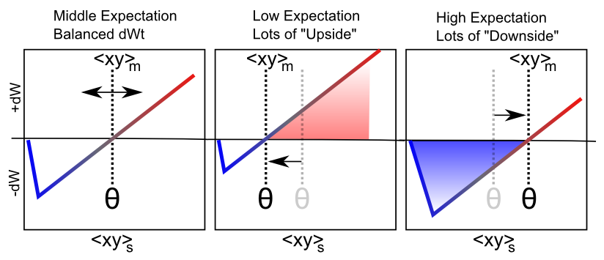
Floating Threshold = Medium Term Synaptic Activity (Error-Driven)
dW = Outcome – Expectation = <xy>_{s} - <xy>_{m}

Slide 25
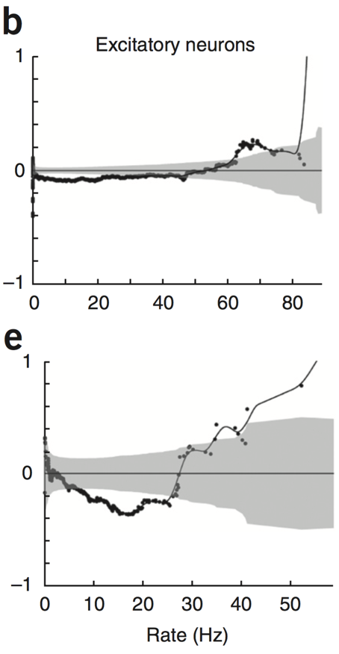
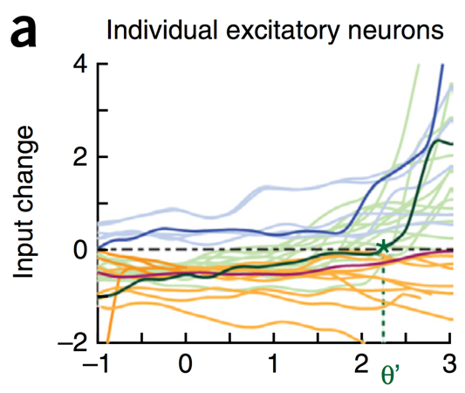
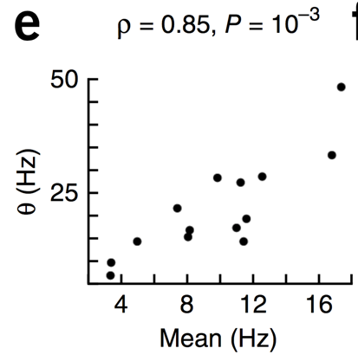
Evidence of Dynamic Thresholds (Lim, McKee, Woloszyn et al., 2015)
b = passive viewing
e = active task
Threshold changes dynamically on a rapid time scale, as a function of short-term activity level!

Slide 26
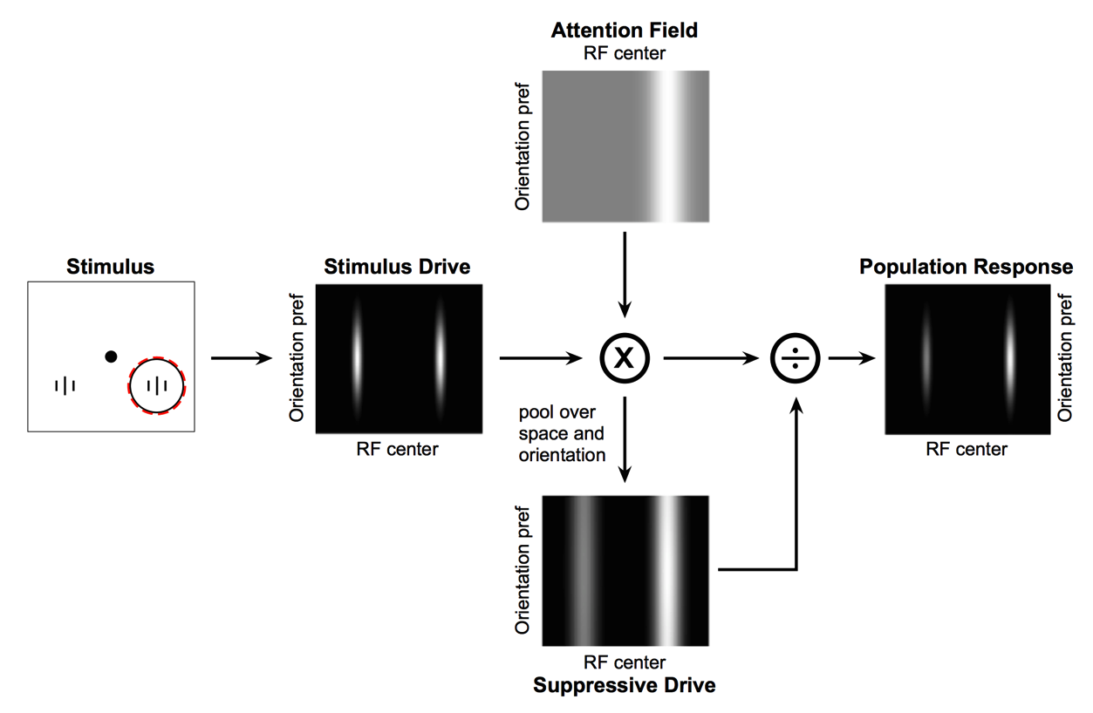
Deep Attentional Dynamics (Reynolds & Heeger, 2009; Grossberg, 1999)
Top-down deep layer
Attentional drive
Inputs to Layer 4
Layer 6 gain control
(Olsen, Bortone et al)

Slide 27
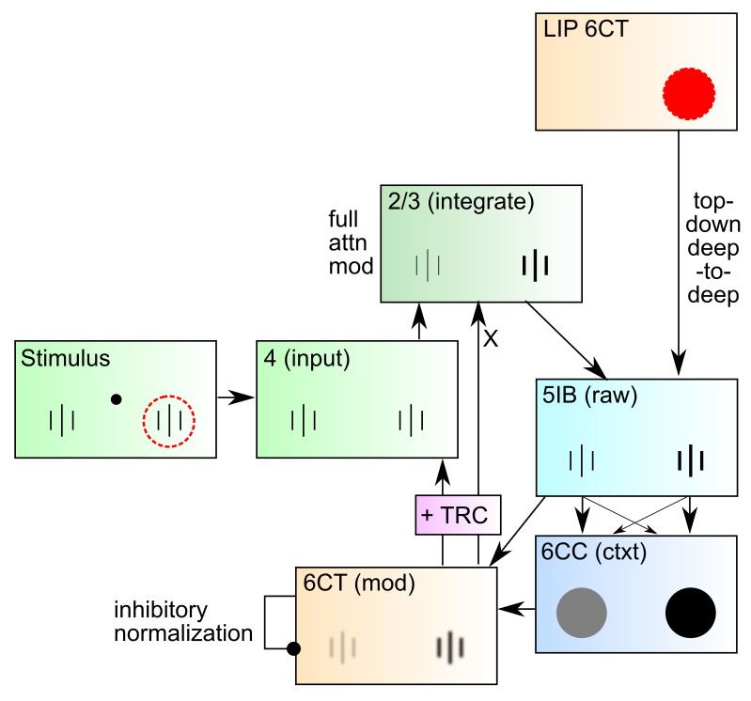
DeepLeabra Attentional Dynamics

Slide 28
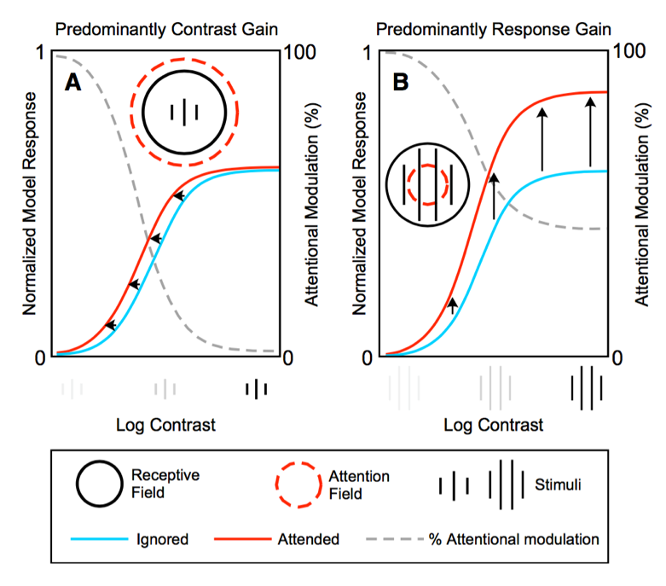
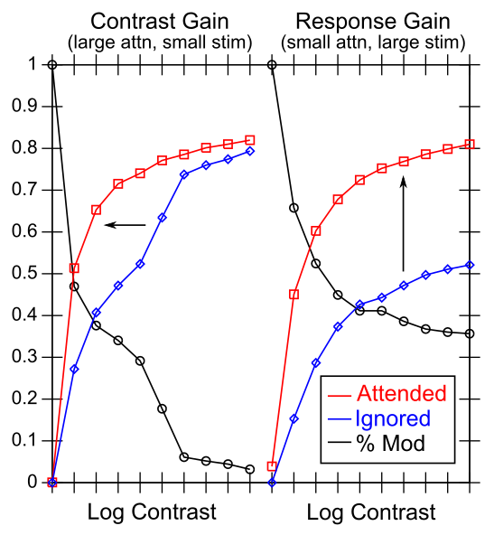
Attentional Dynamics Results

